Slide 1



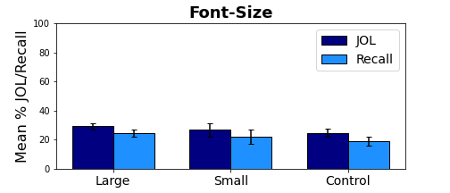
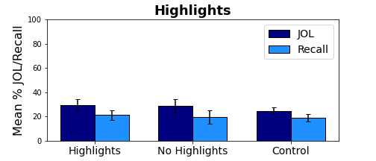
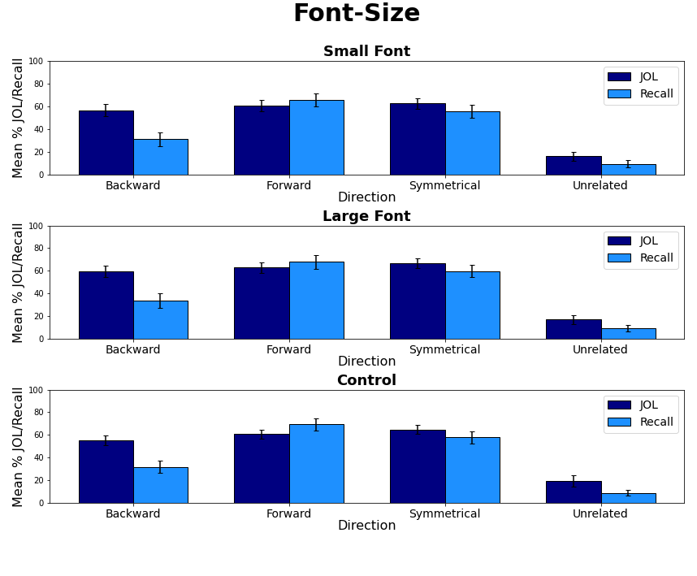
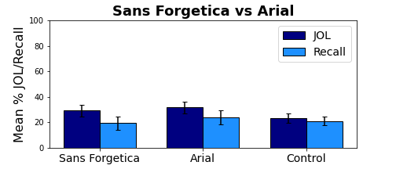
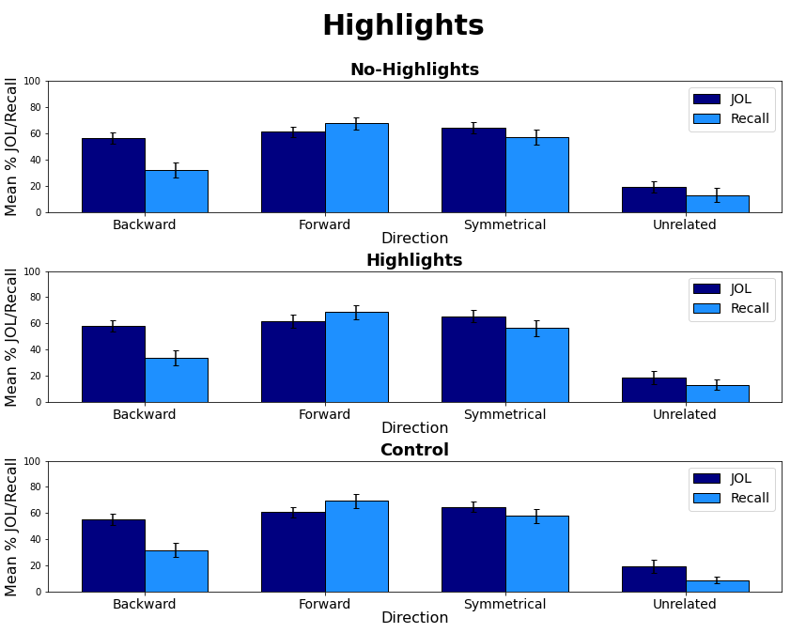
Perceptually Fluent Features of Study Words Do Not Inflate Judgments of Learning: Evidence from Font Size, Highlights, and Sans Forgetica Font Type.
Nicholas P. Maxwell, Trevor Perry, & Mark J. Huff
Introduction
Examining the relationship between one’s predicted versus actual memory performance is the primary goal of metamemory researchers. A common method for examining this relationship is instructing participants to provide judgments of learning (JOLs) in which participants rate the probability that they will be able to later recall a target word from a studied cue-target pair (e.g., bank-interest) when only a cue word is provided at test (e.g., bank-______).
While JOLs are often predictive of future recall, certain factors can produce metamemory illusions where JOLs underpredict or overpredict recall. For example, perceptual cues have been shown to affect a variety of judgment tasks, including affective judgments (Reber, Winkileman, & Schwarz, 1998), veridicality judgments (Reber & Schwarz, 1999), and importantly JOLs (Rhodes & Castel, 2008). Rhodes and Castel presented participants with items that were studied in either large (48-pt.) or small (18-pt.) font and demonstrated a font-size effect in which JOLs were increased for large font without concomitant increases to recall.
The goal of the present study was to provide a further test of the font-size effect while extending it to include other perceptual manipulations. First, Experiment 1 sought to replicate the font-size effect for related and unrelated pairs while testing whether the effect would extend to highlight. Next, Experiment 2 provided a replication of Experiment 1 using only unrelated pairs. Finally, Experiment 3 tested whether JOLs and recall would be affected by Sans Forgetica, a disfluent font that is perceptually difficult to process but purported to benefit memory via desirable difficulties (Earp, 2018)
General Method
Results – Experiment 2
Bars = 95% CI
Study/JOL:
JOL Ratings
(0-100 Scale)
Test:
Cued-Recall
Filler Task
Experiment 1: Font-Size vs. Highlighting vs. Control (related and unrelated)
Experiment 2: Font-Size vs. Highlighting vs. Control (unrelated only)
Experiment 3: Sans Forgetica vs. Control (unrelated only)
Results – Experiment 1
Results – Experiment 3
Materials
Bars = 95% CI
Experiment 1: 180 word pairs taken from Maxwell and Huff (2021).
(Forward, backward, and symmetrical paired associates and unrelated pairs; 40 of each type)
Bars = 95% CI
Conclusions
The primary goal of the present study was to investigate the effects of perceptual fluency on JOLs by first evaluating the font-size effect and testing whether this effect would extend to highlighting (Experiments 1 and 2) and next testing the effects of disfluent Sans Forgetica font on JOLs and cued-recall. While font-size increased both JOLs and recall rates similarly regardless of whether participants studied mixed lists of related and unrelated pairs or only unrelated pairs, JOLs were not overly inflated relative to recall. Finally, Experiment 3 showed that Sans Forgetica – a font designed to improve retention, can result in a memory cost under certain circumstances. Finally, our use of control groups within each experiment proved a baseline comparison group given possible mixed-list carryover effects. Taken together, this set of experiments provides a greater understanding of how perceptual features influence JOLs and recall within the context of cued-recall testing.
Experiments 2 and 3: 180 unrelated word pairs.
Font-Size
Highlighting
Mouse-Cheese
Mouse-Cheese
Mouse-Cheese
Mouse-Cheese
Sans Forgetica
Control
Mouse-Cheese
Mouse-Cheese
Mouse-Cheese
Mouse-Cheese
All pairs were matched on SUBLTEX frequency, concreteness, and length
Correspondence can be addressed to nicholas.maxwell@usm.edu.
More info available at: www.macapsych.com | https://osf.io/3xwdr/

